Slide 1
Data Engineering
Arend Valvekens, Mardiros Gundes, Simon Stercks, Milan Vermeiren, Bram Baestaens, Robin Dewinter

Slide 2
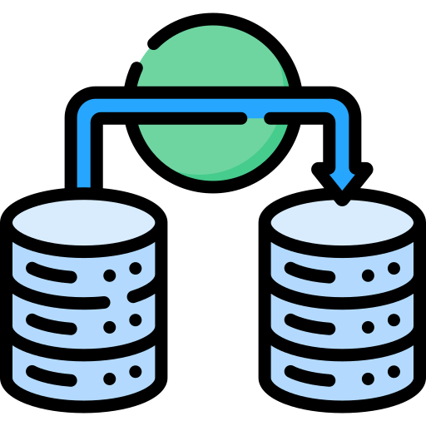
data migration
Moving data around = simple copy paste operation
Becomes complicated -> millions of data units
Underestimation -> extra time and money

Slide 3

data migration
Transfer of existing historical
Not simple -> involves a lot of preparation
Activities include
Planning
Backups
Quality testing
Validation of results
…
Notes:
what is it -> transfer of existing historical data to a new storage system or file format

Slide 4
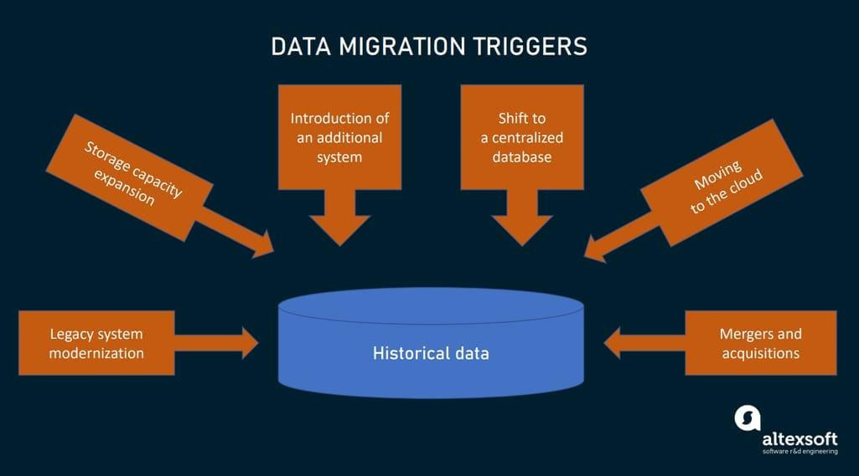
data migration
Notes:
usually data migration happens for a reason and theres certain triggers for it
legacy system modernization; implementing a new technology
mergers and acquisitions; in order to unify company systems and databases

Slide 5
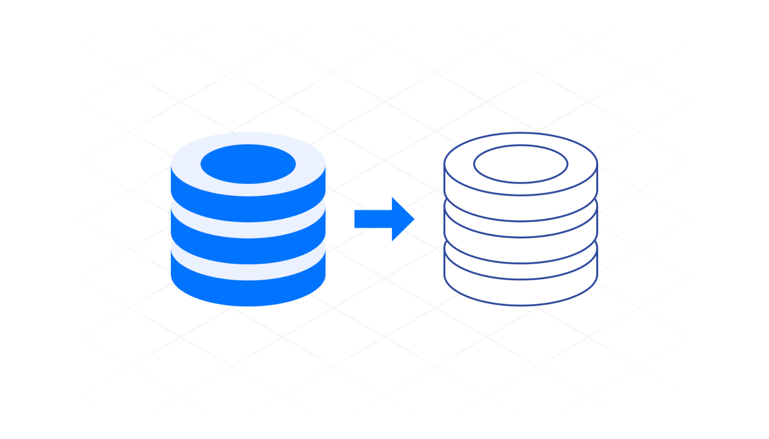
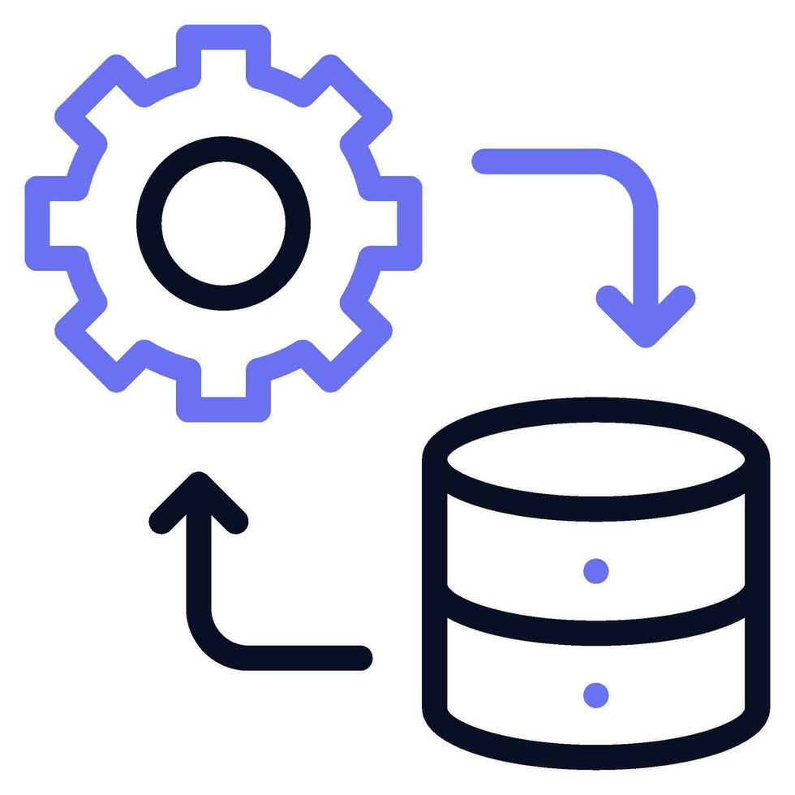
data migration
Often confused with other processes involving a lot of data
Data integration and data replication

Slide 6

data migration vs data integration
Data migration -> dealing with internal information
Data integration -> combining data from multiple sources
Enable connectivity between different systems
Notes:
dealing with internal information in the company
combining data from multiple sources outside and inside the company into a single view
main goal of data integration is to enable connectivity between different systems

Slide 7
data migration vs data replication
Data migration -> data transferred to new location
Eventually abandon the old system or db
Data replication -> data is periodically transported to target location
Without deleting it’s source
Starting point but no defined completion time
Can be part of the integration process

Slide 8

types of data migration
6 types commonly used
Storage migration
Database migration
Application migration
Data center migration
Business process migration
Cloud migration

Slide 9

storage migration
Occurs when: new technology -> discard out-of-date equipment
Transport from one physical medium to another
Examples:
Paper to digital docs
HDD to SSD drives
Main server storage to cloud storage
…

Slide 10
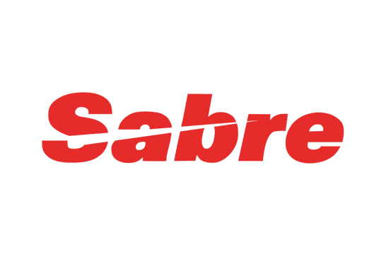
importance data migration
The issue isn’t storage space
The need for upgrading to new technologies
Migrating large scale systems can take years
Example: sabre
Second largest GDS
migrate to google cloud
3 years; 2020 -2023
Notes:
data migration is very important for businesses but there’s one issue with it.
main issue is not that there isn’t enough storage space but it’s the ned for these companies to keep upgrading to new technologies
the migration of large scale systems can take years
an example is sabre: they are a travel company which manages flight and customer data and much more
they have the second largest GDS in the world (global distribution system)
basically it is a network that allows travel agencies to access and book real time inventories like flights, hotels and car rentals.
sabre migrated their entire system to the google cloud in order to improve scalability, speed and cost efficiency.while also leveraging cloud based AI for better data processing and personalized services.

Slide 11

database migration
Data is typically stored in a DBMS
DBMS = software designed to store, retrieve and manipulate data
Database migration often means
Latest DBMS version
Switch to new DBMS eg. mysql vs postgresql

Slide 12
application migration
Change enterprise software
Example: hotel implements a new property management system
Requires moving data from one environment to another
Old and new infrastructures -> often unique data models/ formats
Main migration challenge -> merging incompatible data models/ formats
requires data transformation
Notes:
The main challenge in migrating between old and new infrastructures is trying to merge incompatible data models and formats.
This often requires transforming data from the legacy system’s structure to fit the new system’s format.
A example of merging incompatible data models is migrating from a structured relational database (like Oracle, or postgres) to a flexible NoSQL database (like MongoDB), which requires transforming structured tables into JSON-like documents.

Slide 13
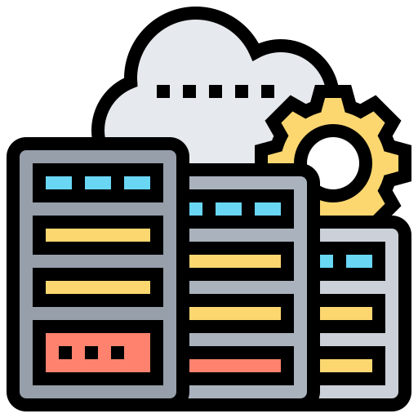
data center migration
Data center -> physical infrastructure to keep data
Room with servers, networks switches, …
Can mean different things
Relocation of existing computers
Relocation of wires
…

Slide 14

business process migration
When different organizations merge for example
Business applications/databases and customer data moved to a new environment

Slide 15

cloud migration
Move data between on-premise and cloud
Move data between clouds
Migration can be short or take even years

Slide 16

approaches to data migration
Several different approaches
Big bang data migration
Trickle data migration

Slide 17
big bang data migration
It all happens in one operation
While data is moving -> downtime
Typically executed during a less busy time
Shortest possible time
Mainly fits small companies with small amounts of data
Not suited for mission critical applications

Slide 18

big bang data migration
Advantages
Less costly
Less complex
Less time
Everything happens at once
Disadvantages
High risk of expensive failure
Requires downtime
Notes:
High risk of expensive failure: can mean data corruption, or bottle necks

Slide 19
trickle data migration
Iterative migration; agile principle
Old and new systems are ran parallel
Will take way longer
Data still needs to be synchronized
Good for medium and large enterprises that can’t afford downtimes
Notes:
will take way longer but your customers can keep using the application
and data still needs to be synchronized between the old and new parallel applications
often times this is very complex

Slide 20
trickle data migration
Advantages
Less prone to unexpected failures
No downtime
Disadvantages
Expensive
Takes longer
Extra resources for keeping two systems running

Slide 21
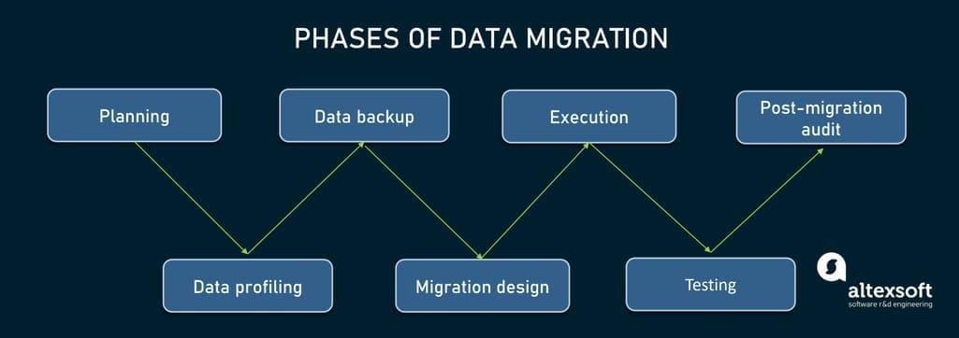
data migration process
planning
auditing and profiling
backups
migration design
execution
testing
post migration audit
Notes:
Planning: Define the migration scope, evaluate source and target systems
Data Profiling: Use automated tools to assess data quality, identify duplicates, and resolve conflicts in the data before migration.
Data Backup: Create a complete backup of all data to safeguard against any potential data loss or failure during migration.
Migration Design: to structure and organize the workflow, create an ETL pipeline with the help of ETL specialists
Execution: execute the migration according to the chosen approach: big bang or trickle to minimize disruptions
Data Migration Testing: Continuously test data quality and integrity throughout the migration to detect and fix any issues.
Post-Migration Audit: Validate the migrated data with key stakeholders, ensuring accuracy before retiring the old system.

Slide 22

Data Integration
Data taken from multiple data sources
Single location (example: data warehouse)
Why?
Needed data is available in one place
Ensures integrity and quality
More reliable Insights
Notes:
Data from multiple sources
Stored in a single location
unified coherent format
used for various analytical or operational purposes

Slide 23
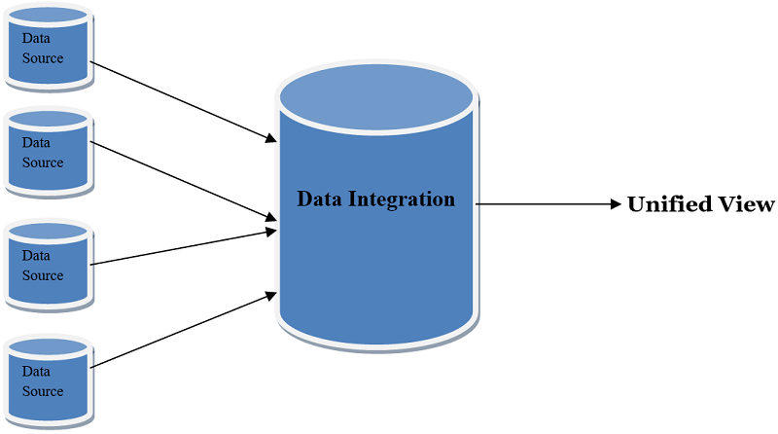
How does it work?
No one-size-fits all
Core elements:
Internal/External data sources
Data integration platform
Data repository (Data lake/warehouse)
Data access layer
ETL process
Newer way: ELT (preferable for cloud environments)
Notes:
Different business have different data structures and systems, so integration methods need to be tailored to their specific use case
ELT leverages processing power of modern data warehouses for transformation

Slide 24
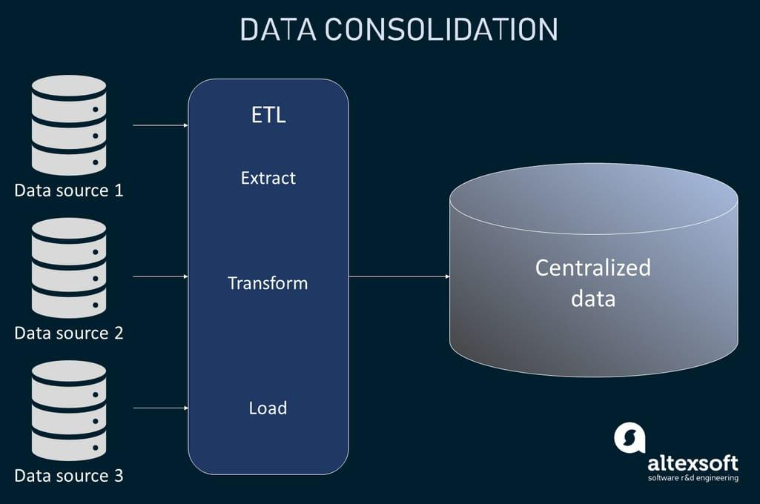
Data Consolidation
Classic method for integration
Often uses ETL
Combining several sources
Cleaning the data
Single Data store (e.g. Data Warehouse)
Notes:
Classic method for data integration, often uses ETL to combine several sources and clean the data by removing duplicate and ensuring data quality. Afterwards it stores the data in a single data store for example a data warehouse for analysis or reporting

Slide 25
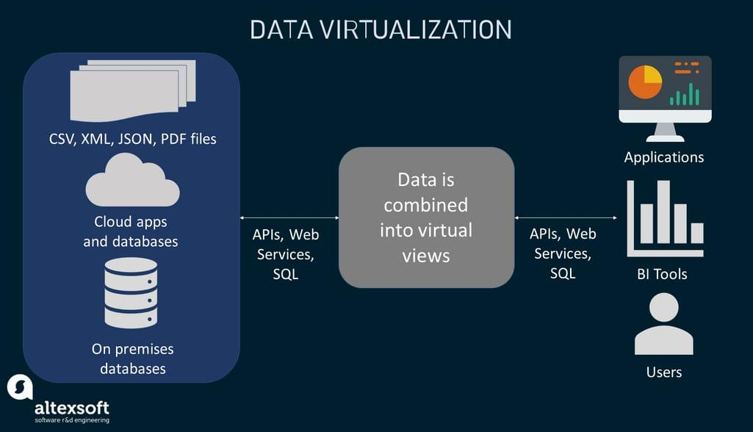
Data Virtualization
Multiple source in virtual layer
Remains in original database
No movement, duplication or transformation
Reduces time & expense
Views to access data on demand

Slide 26
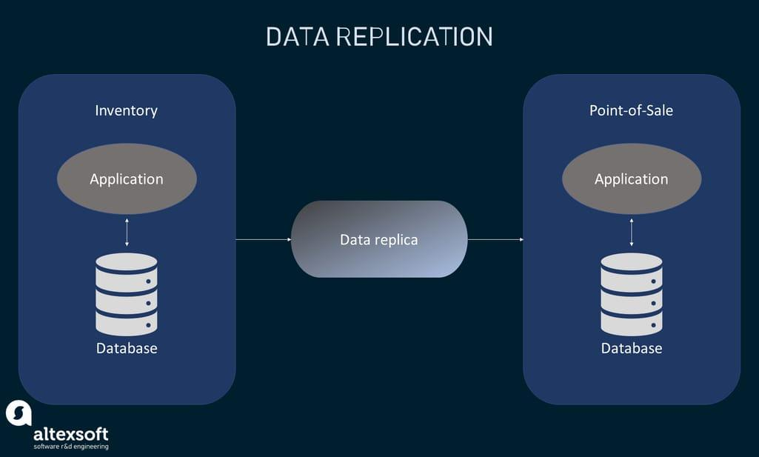
Data Replication
Copying from one system to another
Different types
Full table replication
Key-based incremental replication
Log-based incremental replication
etc.
Can optimize performance
Notes:
Copying from one source system to a target system
full table replication — copying all the new, updated, and existing data from the sources to the destination;
key-based incremental replication — copying only data that has changed since the previous update; and
log-based incremental replication — copying data based on the changes in the log files of source systems.
Data replication can optimize performance by spreading request across multiple different servers or location

Slide 27
Manual integration
Manually integrating data
Human-driven instead of technical tools
Time consuming
Limited scalability
Used for small dataset with unstructured data
Notes:
The ETL process requires significant time and effort due to lack of automation
Manual method struggle to keep up with increasing complexity
Best used for small or unstructured dataset or when automated tools may not be applicable

Slide 28
Application-based integration
Connecting applications, systems and subsystems
Focus on efficient exchanging data
Real-time synchronization
Example:
Using an API to retrieve and send data

Slide 29
Middleware data integration
Layer between applications to transfer data
Can perform transformations
Makes data compatible with new systems
Useful for legacy systems
Example:
Enterprise Service Bus (ESB)
Provides centralized platform for routing transforming and managing data
Notes:
Somewhat similar to application based integration but is often more complex
Application based is for example through API’s
Example: Enterprise Service Bus (ESB): ESB provides a centralized platform for routing, transforming, and managing data flows across multiple services and applications, ensuring scalability and flexibility in integration.

Slide 30
Uniform data access integration
Access to different data sources
Unified interface
Can be difficult to implement:
Different systems use different data structures
Example:
Data virtualization
Notes:
Allows for access to different data source though a single unified interface, the goal is providing a single interface for interacting with multiple data sources, and so making data accessible without worrying about underlying systems

Slide 31
DATA PREPARATION
Very important
Bad data = Bad output
Understand your data

Slide 32
Prediction model for death risk of pneumonia symptoms
Filter high and low death risk symptoms
Decision who goes to the hospital or not
Historical data
Asthma patients always went to hospital

Slide 33
Data quality
Human errors
Formatting data
Replacing missing values

Slide 34
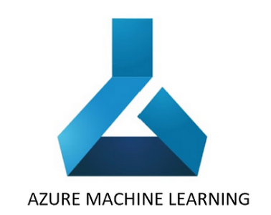
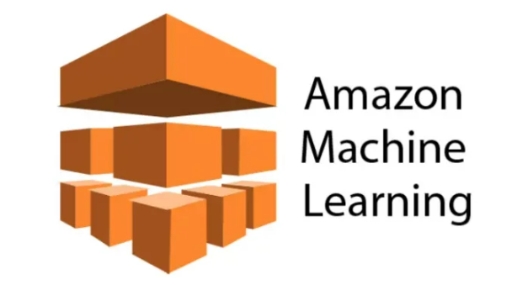
Data preparation tools
Azure machine learning
Amazon ML

Slide 35
Data rescaling
Too many dimensions
Categories overweight others
Min-max normalization
Transforming numerical values into ranges
Decimal scaling

Slide 36
Discretize data
Turn numerical values into categorical
Age groups

Slide 37
Structured vs Unstructured
Data exists in a plethora of different forms and sizes
Most of it can be presented as structured data and unstructured data.

Slide 38
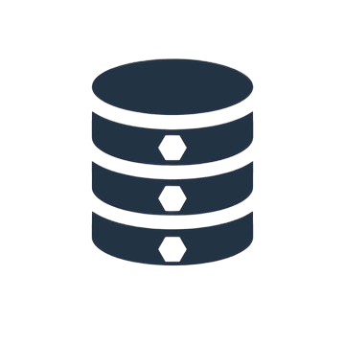

Structured data
Definition
Highly organized,factual,and fits into predefined model.
Typically consists of rows and columns
Characteristics
Quantitative (easily to count, measure, and express data in numbers)
Usually stored in RDBMS
Easy to do analytics

Slide 39
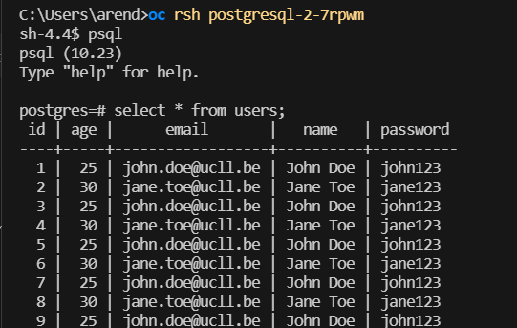
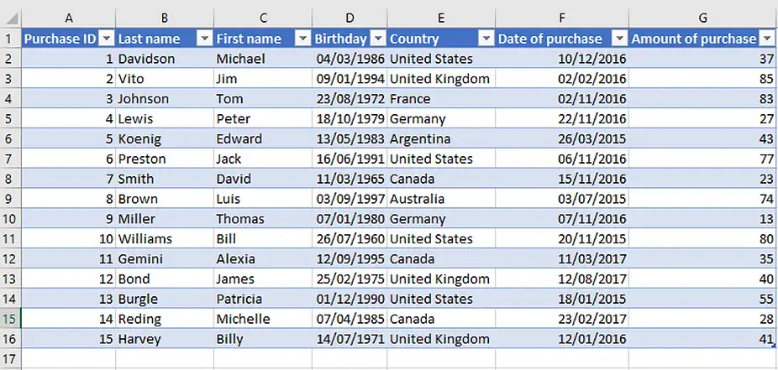

Slide 40
Unstructured data
Definition
Unstructured data doesn’t follow a specific format or structure
Exists in its native form and can come in a variety of file types and content
Characteristics
Qualitative (subjective and interpretive nature)
Best stored in a NoSQL db or Data Lakes

Slide 41
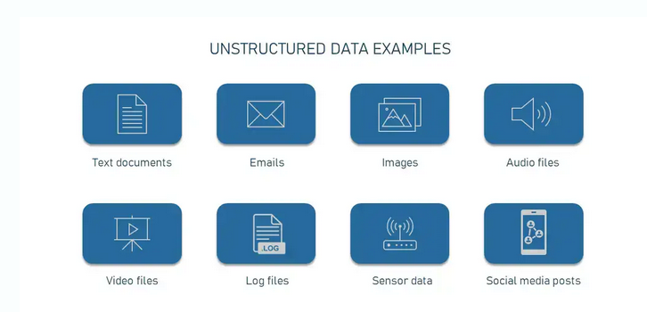
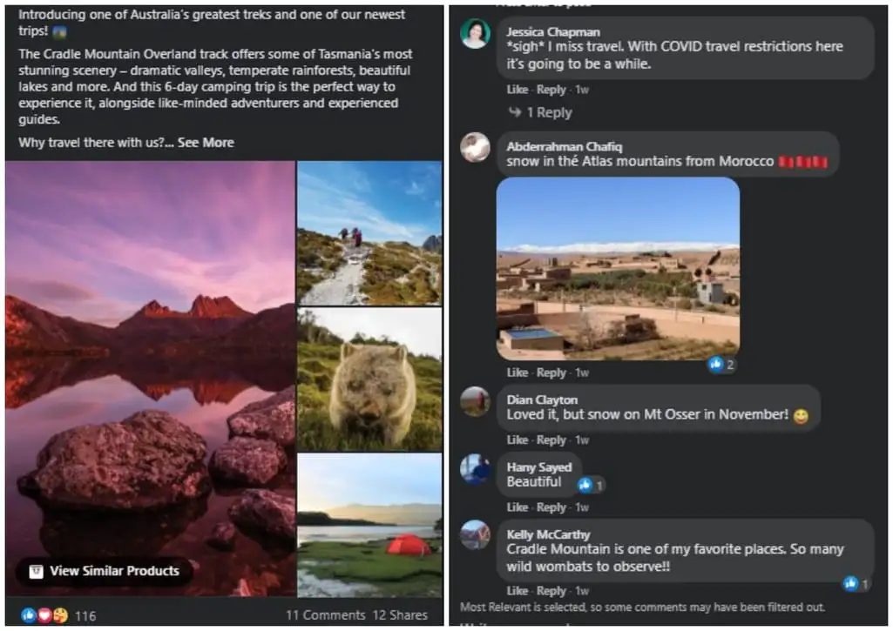

Slide 42
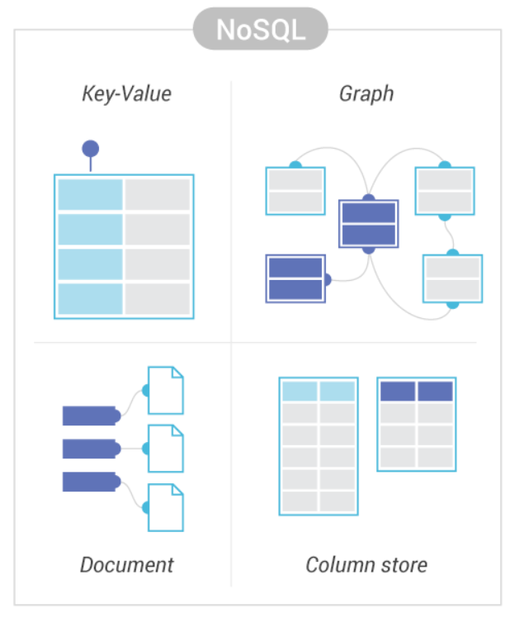
About NoSQL
NoSQL => Not only SQL
These databases have various data models and they store data in a non-tabular way.

Slide 43
About NoSQL
Key-value stores data with simple indexed keys and values.
Wide column uses tables, rows and columns. But the format and naming of the columns can vary in different rows within the same table.
Document database A more complex and structured version of the key-value model, which gives each document its own retrieval key.
Graph database presents interconnected data as a logical graph.

Slide 44
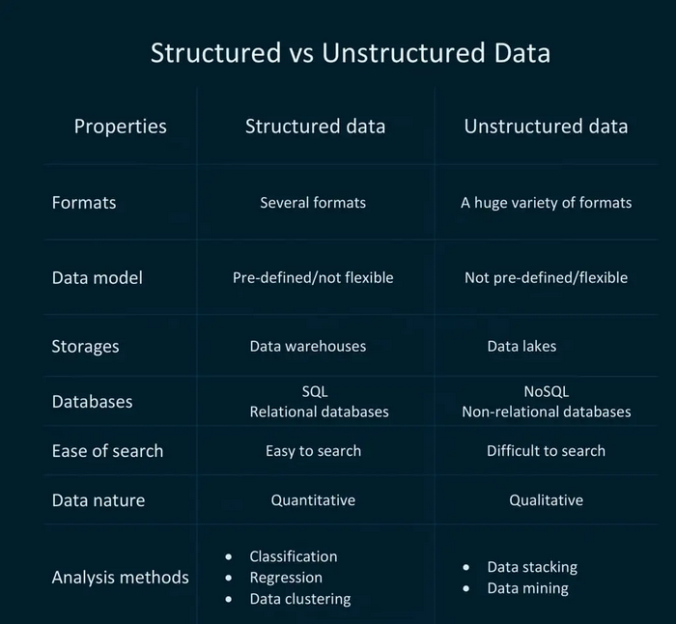

Slide 45
About analysing qualitative data
Data stacking
Is about grouping similar types of data together to see overall patterns (like sorting feedback into categories).
Data mining
Is about finding hidden patterns in large datasets, which can help you predict future actions (like knowing people who buy pet food also buy pet toys).

Slide 46
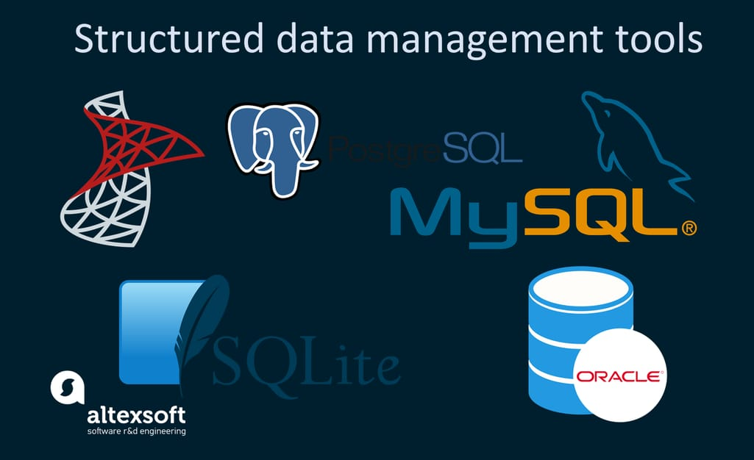
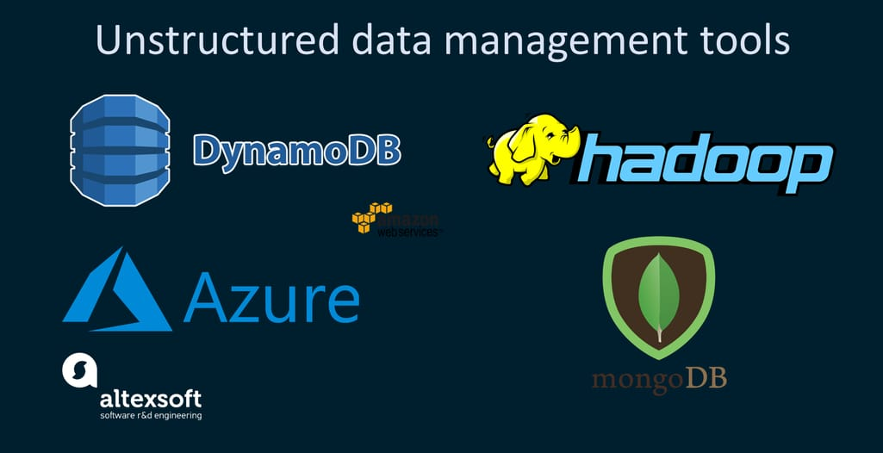
Management tools

Slide 47
Why Unstructured Data Matters
Accounts 80% of all data
Value in Analysis:
Unstructured data contains customer insights, sentiment, and behavior patterns that structured data doesn’t capture.
Importance for Businesses:
Ignoring unstructured data means missing out on valuable information that can enhance customer experience and decision-making.

Slide 48
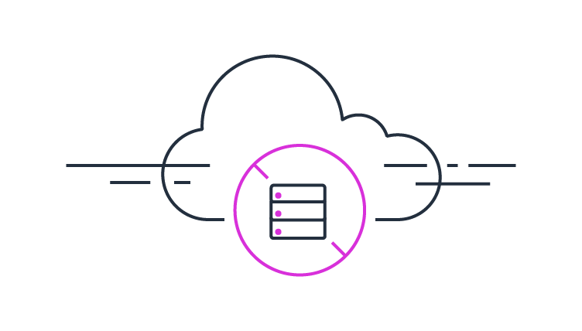
Serverless ETL/ELT pipelines

Slide 49

Serverless
What is serverless
Hardware
waste
Pay as you go
Scalability
Notes:
Hardware
Managed by Provider: In serverless, the hardware (e.g., servers, storage) is fully managed by the cloud provider.
Abstracted Away: Developers don’t interact with the physical hardware, which simplifies infrastructure management.
Flexibility: No need for provisioning or capacity planning, as these are handled by the provider.
Waste
Reduced Resource Waste: Traditional infrastructure often has unused capacity, leading to wasted resources.
Efficiency: Serverless eliminates idle server time, as resources are only allocated during function execution.
Environmental Benefit: Minimizing idle resources can reduce energy consumption, contributing to a more sustainable approach.
Pay as You Go
Cost Model: In a serverless setup, you pay only for the compute resources you use when your code is running.
Cost-Efficiency: No charges for idle time, making it ideal for applications with sporadic traffic.
Granular Billing: Costs are typically calculated based on requests and compute time down to milliseconds, optimizing spend.
Scalability
Automatic Scaling: Serverless platforms automatically scale resources up or down based on demand.
No Capacity Planning: Developers don’t need to worry about scaling limits; the provider handles it.
Perfect for Variable Workloads: Serverless is well-suited for applications with variable or unpredictable workloads due to its rapid scalability.

Slide 50
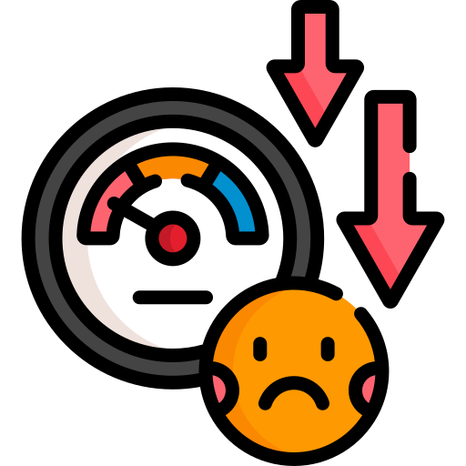

Serverless
Benefits
scalability
pay as you go
Fast Time to Market
Drawbacks
Performance Variability
limited control
debug challenges
Cost Efficiency Requires Performant Code
Notes:
Benefits
Scalability
Serverless platforms automatically scale resources up or down based on demand.
No need to manually adjust infrastructure; the service provider handles it.
Ideal for applications with fluctuating traffic patterns.
Pay-as-You-Go Model
You only pay for the actual compute time used when functions are active, which can save costs for applications with intermittent usage.
No expenses for idle resources, making it more economical for low-usage applications.
Fast Time to Market
No infrastructure management allows developers to focus more on coding and deploying new features.
Built-in integrations and managed services speed up development, allowing faster iterations and quicker deployment.
Drawbacks
Performance Variability
Cold starts (delay when a function is called after a period of inactivity) can slow response times, especially for latency-sensitive applications.
Performance may vary due to shared infrastructure with other users.
Limited Control
Less control over infrastructure and environment configuration (e.g., memory allocation, CPU management).
Providers may impose restrictions on runtime or dependencies, limiting flexibility.
Debugging Challenges
Debugging can be challenging since serverless functions run in isolated environments.
Limited visibility into the underlying infrastructure, making it difficult to trace issues.
Cost Efficiency Requires Performant Code
Although serverless is cost-efficient, poorly optimized code can lead to high expenses.
Requires careful optimization to minimize compute time and costs.

Slide 51
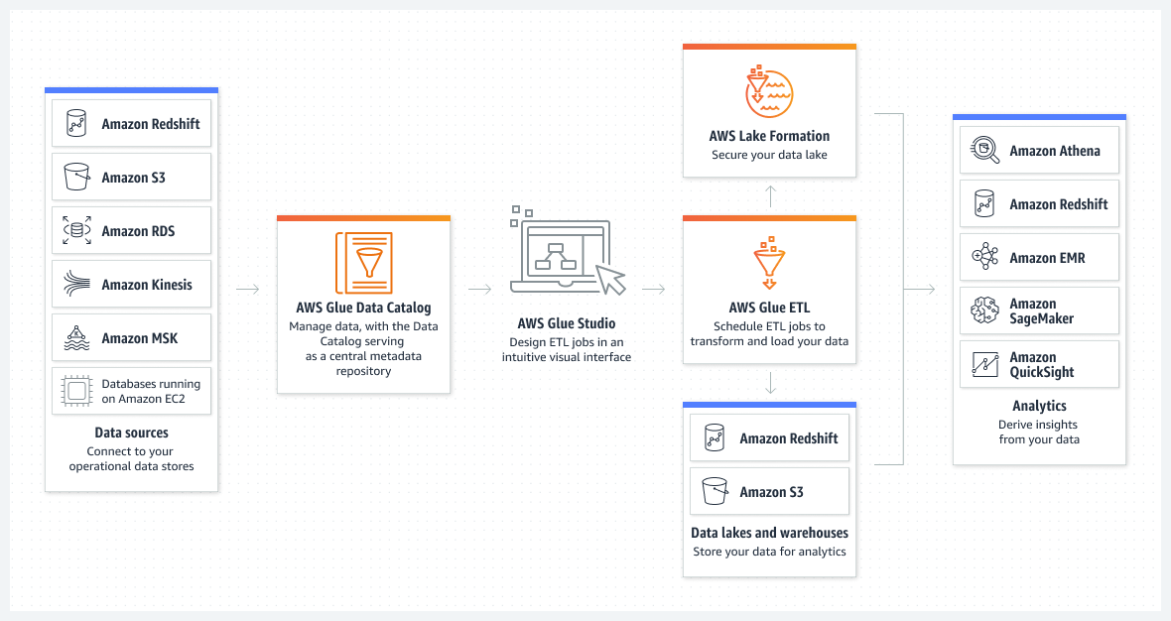
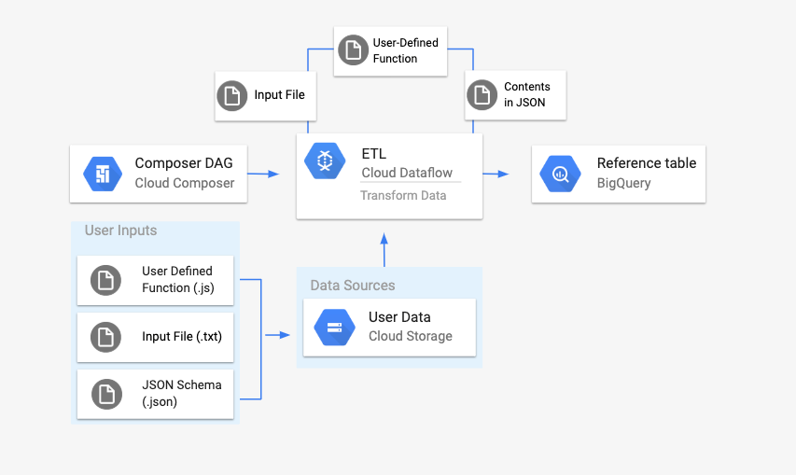
Tools and examples of Serverless
aws glue
google cloud dataflow
Notes:
amazon orange parts are serverless google cloud

Slide 52
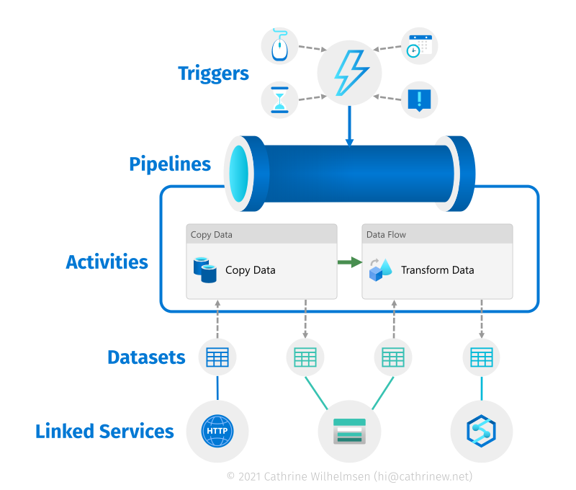
Tools and examples of Serverless
Azure data factory
Notes:
serverless parts of data factory Pipelines (overall orchestration)
Copy Activity (data movement)
Mapping Data Flows (data transformation)
Azure Synapse Analytics (Serverless SQL Pools) for querying
Azure Functions (invoked within ADF pipelines)
Event-Based Triggers (automation)
Azure Data Lake Analytics (for querying in serverless environments)

Slide 53
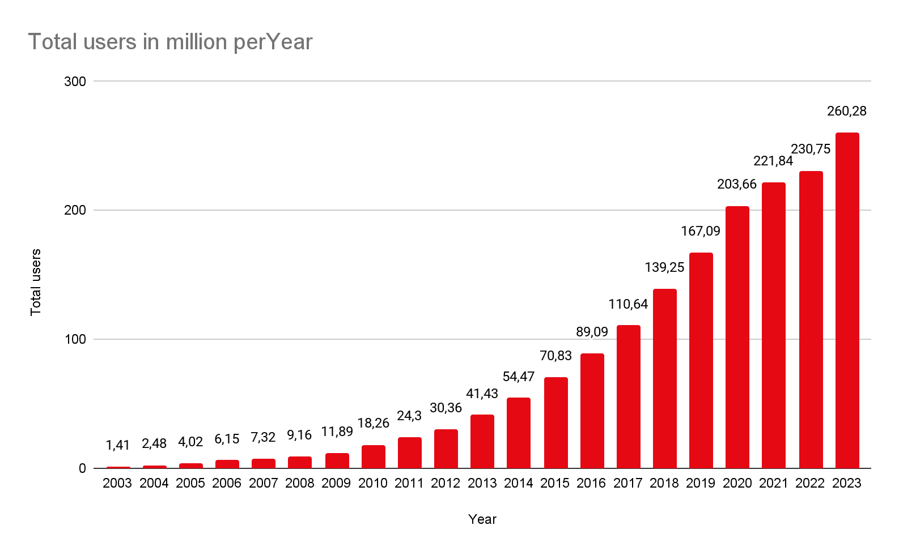
Example of a serverless ETL
2008-2015
content encoding
aws lambda
automatically deployed
backup
monitor
integrity
security
automatic shutdown
automatically verifies
Notes:
netflix went serverless 2008-20015
1 Content Encoding Using AWS Lambda, they split each video into 5-minute chunks. Each chunk is encoded into 60 different streams (resolutions). Once complete, it is automatically deployed.
2 Backup System AWS Lambda monitors file changes, checks integrity, and backs up files. If issues are detected, Lambda can restart the process from the source.
3 Security Management Lambda ensures instances meet security standards and triggers alerts for unauthorized access.

Slide 54
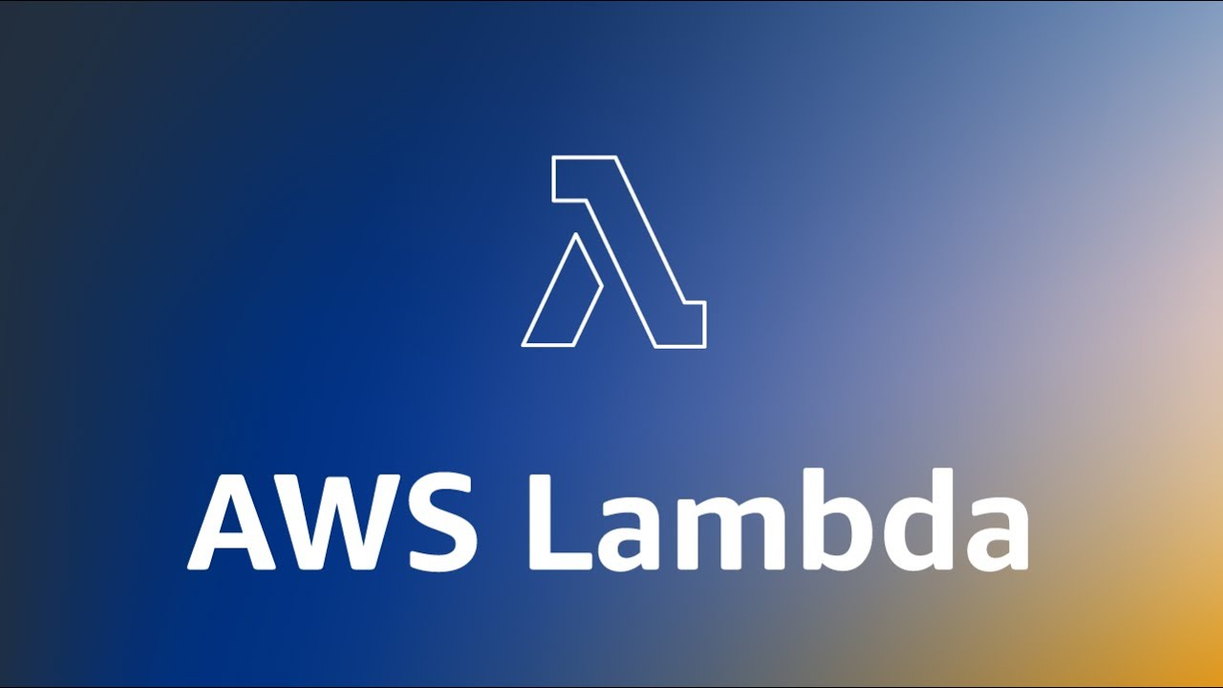
Example of a serverless ETL
4. production monitoring
real-time validation
efficiency improvements.
5. server management
lambda deployments
quickly respond business needs
6. real time analytics
amazon kinesis streams
respond to issues in realtime
Notes:
Production Monitoring Lambda’s event system validates configurations in real-time, improving production monitoring and efficiency.
Server Management Lambda handles server deployment, compliance, and configuration, freeing Netflix from manual server management.
Real-Time Analytics with Kinesis Kinesis processes terabytes of log data daily, providing real-time analytics for fast issue resolution and high availability.

Slide 55

Serverless Pricing comparison
aws glue
service | time/month
total usage of spark jobs | 60hrs
python shell jobs | 15hr
interactive session | 30hrs
ec2 instance specs: 1vcpu 8gb of memory
10gbit networking Price 31$
total hours: 720
specs: 4vCpus 16gb memory 10gbit networking
Price 11$
total hours: 105
Notes:
Spark Jobs (Apache Spark ETL Jobs):
Large-Scale Data Processing: Efficiently handle big data using distributed computing.
Complex Data Transformations: Perform tasks like aggregations, joins, and filtering at scale.
High Performance: Process data quickly with in-memory computing.
Python Shell Jobs:
Lightweight ETL: Ideal for simple, script-based data transformations.
Custom Processing: Run specific Python scripts for automation or data manipulation.
Low Overhead: Suitable for small datasets without the need for distributed processing.
Interactive Sessions:
Ad-Hoc Data Exploration: Query and explore data interactively.
Prototyping & Debugging: Test and refine ETL code in real time.
Development & Testing: Build and test pipelines incrementally in a flexible environment.

Slide 56
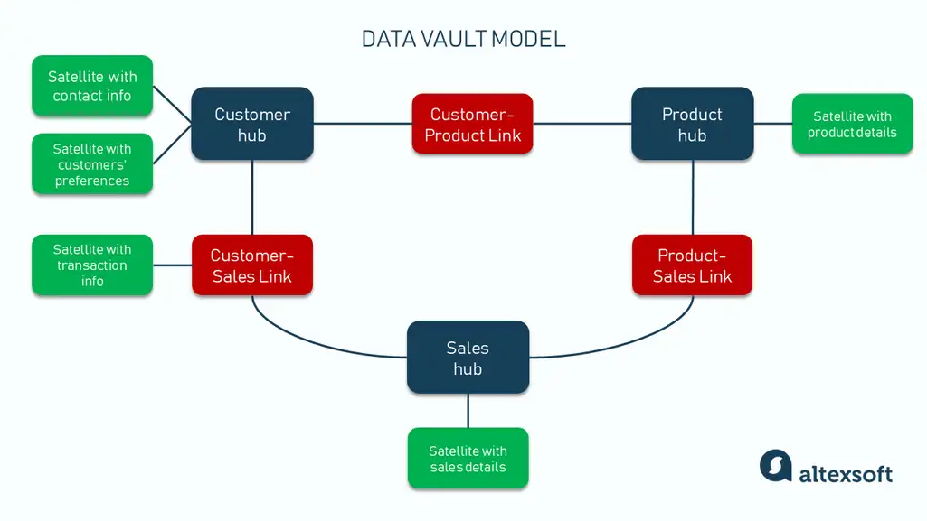
Data vaults revisited

Slide 57
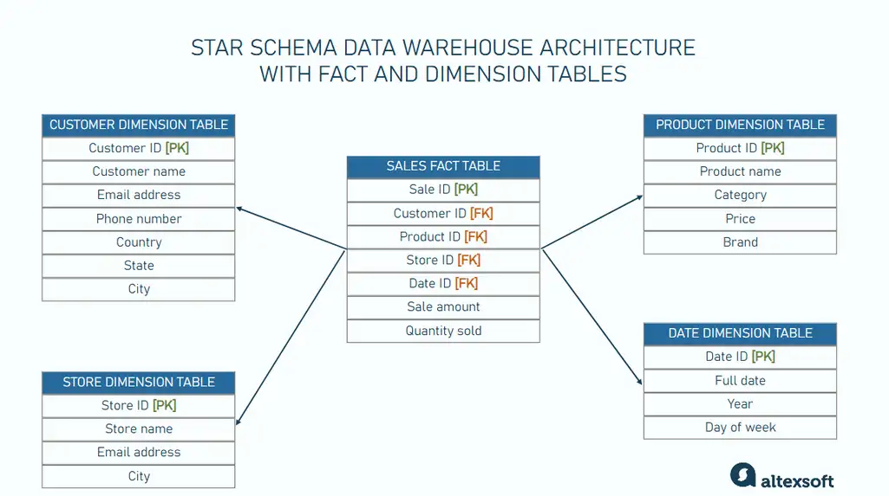
Data vault vs traditional schema warehouse
Structure and Modeling
Handling of Historical Data
Overwriting and SCD vs new entry every change in a satellite table
Data Agility
Rigid schema design and ETL updates vs agile and modular by new hubs and links
Query Performance
ideal for BI vs improved scale- and flexibility
Capacity to Handle Big Data
Scalability

Slide 58

Data Vault best practices
Data validation rules
Start small, scale incrementally
Error tables
record of quality problems
Consistent naming conventions
HUB_, LINK_, SAT_,
Optimize for parallel processing
enhances efficiency and reduces overall processing time

Slide 59
Sources
https://www.altexsoft.com/blog/data-migration/
https://www.ttgasia.com/2023/09/04/sabre-deepens-ai-application-moves-all-gds-business-to-google-cloud/
https://www.altexsoft.com/blog/data-vault-architecture/
https://backlinko.com/netflix-users
https://www.cloudflare.com/learning/serverless/what-is-serverless/
https://datascientest.com/en/gcp-dataflow-what-is-it-whats-it-for
Netflix AWS: The Netflix Serverless Case Study | Dashbird
https://docs.aws.amazon.com/glue/latest/dg/what-is-glue.html

Slide 60
data integration:
https://www.altexsoft.com/blog/data-integration/
https://www.ibm.com/topics/application-integration
https://www.dataversity.net/the-fundamentals-of-data-integration/
https://www.ibm.com/think/topics/data-virtualization
https://www.ibm.com/products/watson-query
https://www.ibm.com/topics/data-integration
https://azure.microsoft.com/en-us/resources/cloud-computing-dictionary/what-is-data-integration
https://www.ibm.com/topics/data-consolidation
https://www.fivetran.com/learn/data-consolidation
https://www.stitchdata.com/resources/what-is-data-consolidation/
https://aws.amazon.com/what-is/enterprise-service-bus/
https://www.ibm.com/topics/data-replication
https://apix-drive.com/en/blog/other/uniform-data-access-integration#introduction
https://www.integrate.io/blog/the-five-types-of-data-integration/
https://www.dataversity.net/the-fundamentals-of-data-integration/
https://www.mulesoft.com/resources/esb/applications-integration
https://azure.microsoft.com/en-us/resources/cloud-computing-dictionary/what-is-data-integration
https://www.softwareag.com/en_corporate/blog/streamsets/optimizing-data-integration-methods-to-align-with-strategic-goals.html

